Slide 1
KNN-Based Digit Recognition
Advanced Computer Architecture - Lab B 2021 Spring
https://github.com/kurimulion/ACA_LabB

Slide 2
Outline
What is k-NN
Digit Recognition
Design
Result

Slide 3
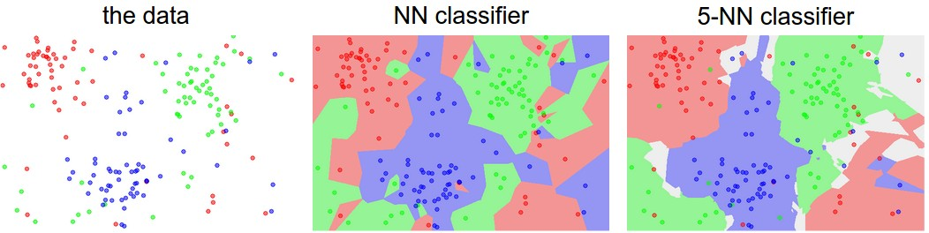
What is k-NN (k-Nearest Neighbor)
k-NN is a machine learning/pattern recognition algorithm for classification
It operates on a simple heuristic: samples of the same class should look similar, like literary
k-NN classifier takes input sample and outputs a class prediction, and the prediction is the outcome of voting by samples in the training set that are k-closest to the input
source: cs231n

Slide 4

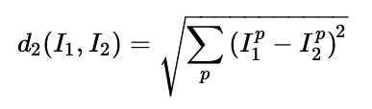
What is k-NN: Distance
There are two hyperparameters we can tune:
The number k
The distance function
There are two common distance functions
L1 distance (we primarily focus on this definition)
L2 distance

Slide 5
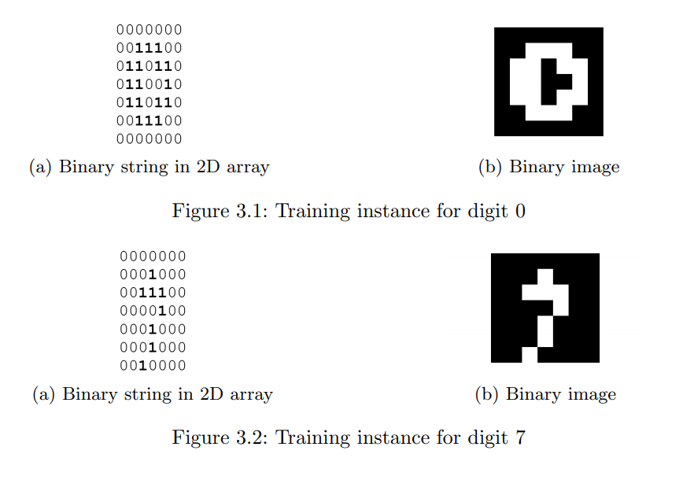
Digit Recognition
In this lab, the task is to classify images of digit with k-NN algorithm
The dataset consists of 18000 49-bit samples as train set and 180 samples as test set

Slide 6
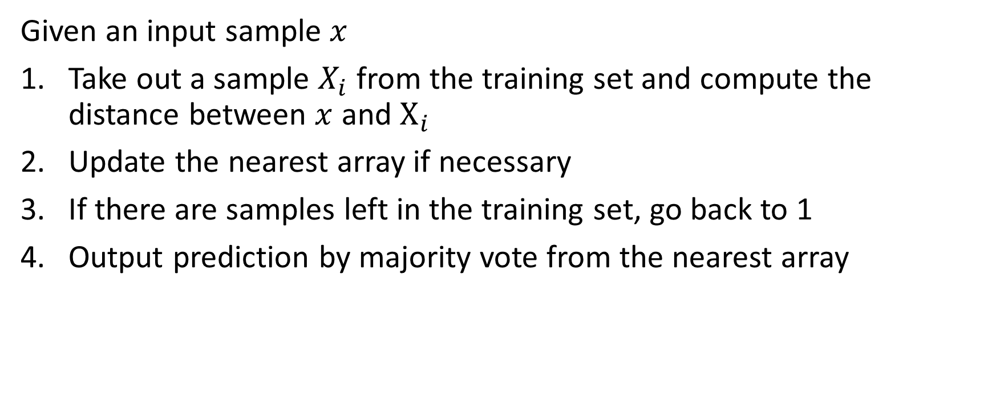
Digit Recognition: Process
Given an input sample $x$
Take out a sample $X_{i}$ from the training set and compute the distance between $x$ and $X_{i}$
Update the nearest array if necessary
If there are samples left in the training set, go back to 1
Output prediction by majority vote from the nearest array

Slide 7
Digit Recognition: Problem
k-NN doesn’t require any training
The major downside of k-NN is that it requires a huge amount of computation during test time
There are many other problems with the k-NN algorithm, like the nature of supervised learning, image variations, etc.

Slide 8
Digit Recognition: From a Hardware Prospective
If we think about it, there are plenty of data parallelism
A potential optimization would be to duplicate a number of computation units
Since each pixel of the image is binary, we can use bitwise operator XOR to compute the absolute difference of each bit position
Setting different k’s may affect performance as well

Slide 9
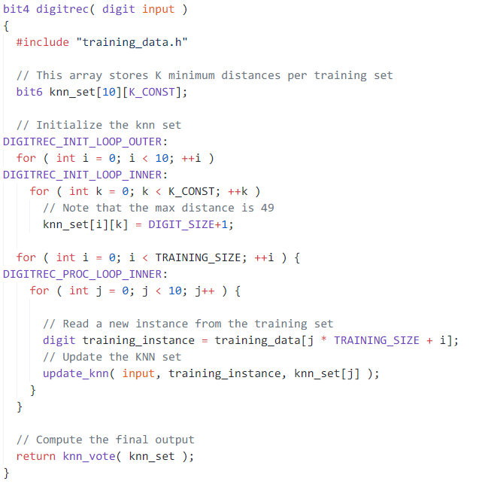
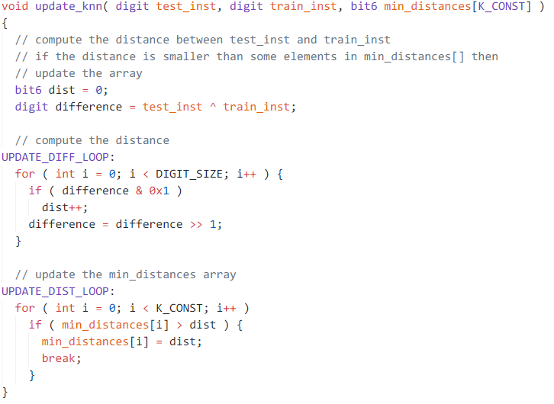
Design
XOR
Initialize the nearest array
Aggregate difference of each bit position
Compute distance iteratively
Update nearest array
Vote and output

Slide 10
Design: Sorcery
Loop unrolling: apply loop unrolling to every loop, and also it’s important that loops are conditioned on constants or some inferable bounds
Array partition: helps sustain concurrency
Arbitrary precision
Pipeline?

Slide 11
Design: Array Partition
k-NN set is further divided into 10 sets each contains k entries
Distances are at most 49
set_directive_array_partition -type complete digitrec knn_set
set_directive_array_partition -type block -factor 10 digitrec training_data
set_directive_array_partition -type complete knn_vote cur_dist
set_directive_array_partition -type complete knn_vote cur_digit
set_directive_array_partition -type complete knn_vote vote

Slide 12
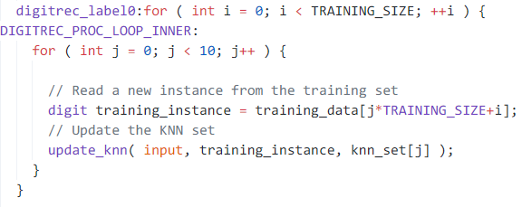
Design: Pipeline
Apply pipelining to main update loop
Also inline update_knn

Slide 13
Result
 | Error Rate | Clock | BRAM | FF | LUT | Latency
Unoptimized | 6.11% | 6.379 | 96 | 347 | 1036 | 1083867
Unroll | 6.11% | 8.750 | 56 | 3556 | 30710 | 39627
Pipeline | 6.11% | 8.713 | 76 | 4045 | 26151 | 1846
19.94x
21.56x
k | Error Rate | Clock | BRAM | FF | LUT | Latency
1 | 9.44% | 8.750 | 56 | 2527 | 22930 | 39607
2 | 10.6% | 8.750 | 56 | 2843 | 24881 | 39614
3 | 6.11% | 8.750 | 56 | 3556 | 30710 | 39627
4 | 6.11% | 8.750 | 56 | 4912 | 38448 | 39652
5 | 6.67% | 8.750 | 66 | 6601 | 45934 | 46885

Slide 14
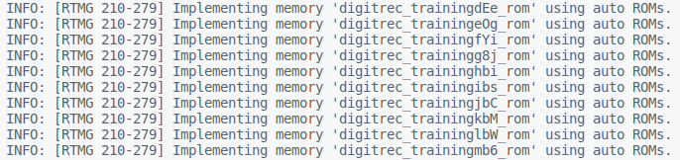
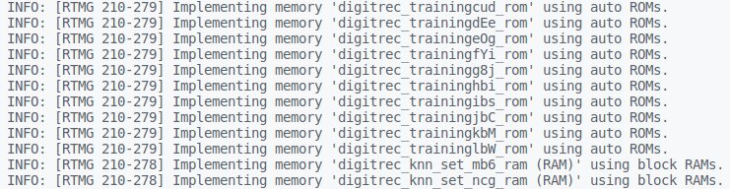
B-Side

Slide 15
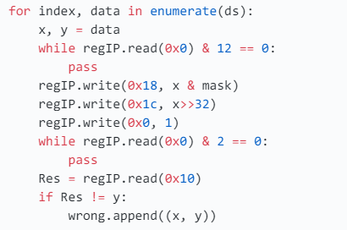
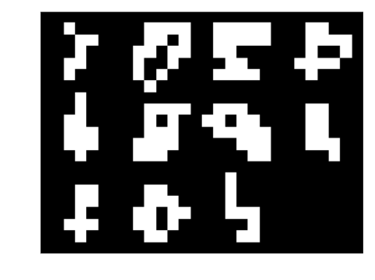
B-Side
Takes about 0.35s to process 180 samples

